Slide 1
Cultural Appropriaton
Is it ok?

Slide 2
Journal
What cultures outside of your own do you admire? Are there any cultural styles or practices that you wish to practice/reflect? Why?

Slide 3
Directions.
Respond to the following slides without oral discussion with your neighbor. Just write a two to three sentence visceral reaction to the images.
There are 10 images.

Slide 4
Respond to the following ads

Slide 5
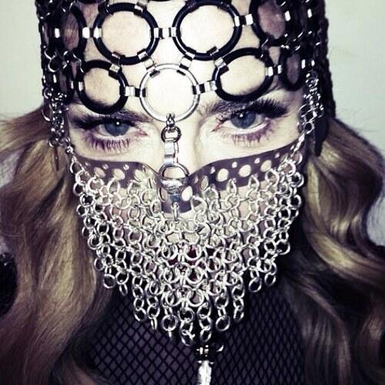
2

Slide 6
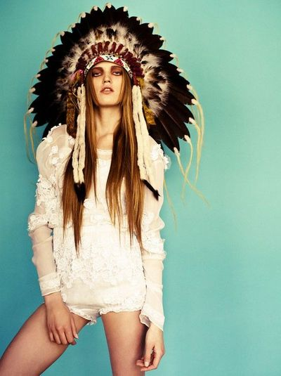
3.

Slide 7
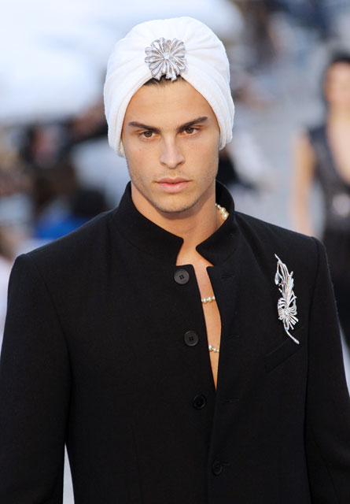
4.

Slide 8
5.

Slide 9
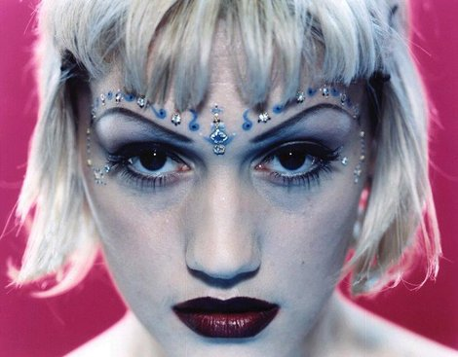
6.

Slide 10
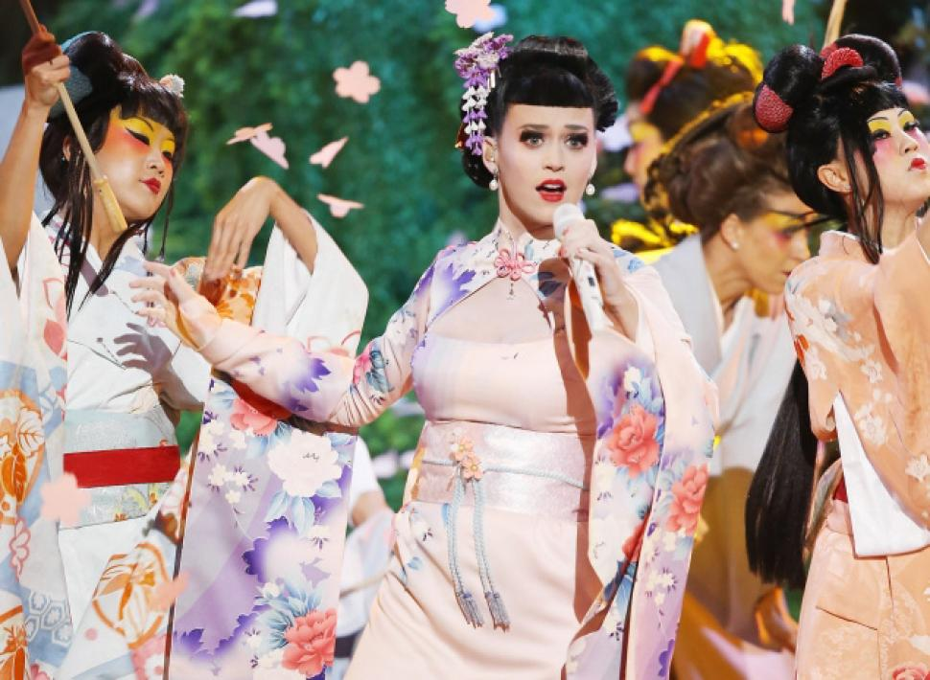
7.

Slide 11
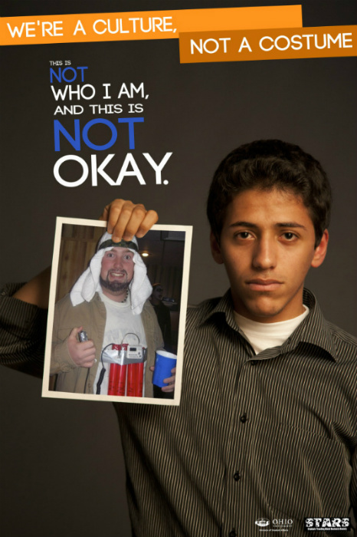
8.

Slide 12
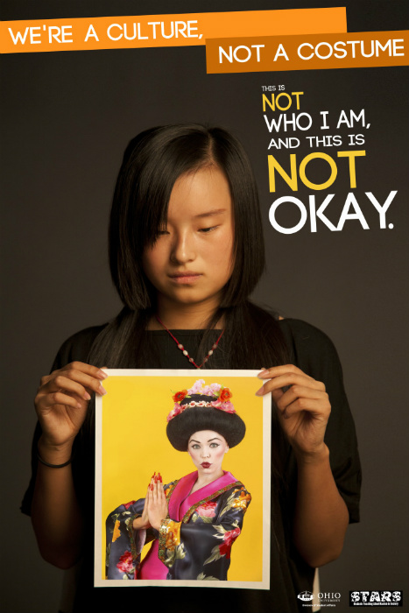
9.

Slide 13
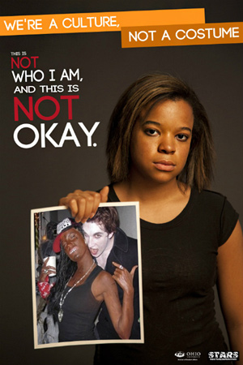
10.

Slide 14
Watch the video below.
https://www.youtube.com/watch?v=zSV7Hi2eYLQ

Slide 15
Read the Opposing opinion
http://www.thedailybeast.com/articles/2014/07/15/you-can-t-steal-a-culture-in-defense-of-cultural-appropriation.html

Slide 16
Using the argument outline, create a solid thesis and one argument paragraph to the following topic:
Does cultural appropriation erase or honor the cultures that make us diverse?

