Slide 1
History
A TOK Dissection

Slide 2
Please Draw History
What is it?
What does it look like?

Slide 3
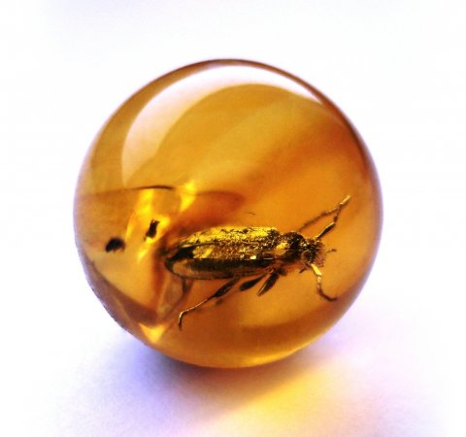
First Questions to discuss
Who or What drives history?
Deity? Are we bugs in amber? Is free will an illusion?
If so, for what are we fighting?
What is the purpose of studying it if we have no control?
The Self? Are we responsible for progressing the world?
Do we learn from our mistakes?
Can we create a utopia? Can we at least strive toward one?

Slide 4
Progressive Philosophy
History
is
Linear
But what is the point?
What is it leading toward?

Slide 5
Progressive Philosophy
Friedrich Hegel
His theory proposes that we are working toward perfectibility and human freedom in conjunction with the Geist (the collective spirit or culture)
We do go backward in order to move forward
History is divided into 3 Stages
Oriental: Only one man, the single despot, is free
Greco-Roman: Only some men are free and some are slaves
Germanic-Christian: All men are free
History can only be viewed and judged holistically (not nationalistic or regional)
This is more religious (There is a beginning and an end)
The major flaw is that Hegel largely ignored Asia, Africa, and the Middle East in his musings.

Slide 6
Progressive Philosophy
Immanuel Kant
Though history is linear, it is not always progressive.
Progress is not always necessary or always inevitable
Humans CAN develop, but do not necessarily choose to develop
All possibilities for development are not explored
History tries to find “universal human law” through a “repugnant spectacle” that will then help us understand our past
We must look universally and holistically in order to find our purpose (like Hegel)

Slide 7
Progressive Philosophy
Karl Marx
Historical Materialism
He was a follower of Hegel but focused on the material, not the spirit
History is broken into four stages of class struggles in succession that work toward perfectibility
The Slave Economy of Ancient Times
The Middle Ages and the Economy of Feudal Serfdom
The Modern Capitalist Production (capital and labor)
The Communist or Classless Society
Weaknesses: Theory vs. Reality

Slide 8
Cyclical View of History
My name is Yon Yonson
I work in Wisconsin
I work in a lumbermill there
The people I meet when I walk down the street
They say, “What ‘s your name?”
And I say…

Slide 9
Cyclical Philosophy
Ecclesiastes: “There is nothing new under the sun; all is vanity and vexation of spirit”
Herodotus: “the cities which were formerly great have most of them become insignificant. And such as are at a present powerful were weak in olden times.”
Aristotle: “Probably each art and science has often been developed as far as possible and has again perished,’ as if the arts and sciences, the products of civilization were once developed and lost, only to be developed again and lost”
Most Chinese believe in cyclical history

Slide 10
Cyclical Philosophy
Spengler: Published The Decline of the West
History is not built upon epochs, but on whole cultures whose rise and fall are chronicled like a biological organism.
Babylonian, Egyptian, Chinese, Indian, Mesoamerican, Classical, Arabian, Western
The Western (or Eurocentric) Civilization is doomed to fail. It is in its last winter
Each civilization has an initial religious identity, a reformation, a period of rationalism, and then renewed religiousness that facilitates its decline.

Slide 11
Cyclical Philosophy
Arnold Toynbee
22 of 26 major civilizations have matured and then self-destructed in the past 6000 years
Those who did succeed did so by listening to the “creative minority” instead of the elite
Civilizations are created through Goldilocks condition
Civilizations die when the resentment of the dominant minority culture creates an irreparable schism in the society through the creation of a “universal state” that stifles political and social growth

Slide 12
Cyclical View
Every extremely popular series to books.
The monomyth

Slide 13
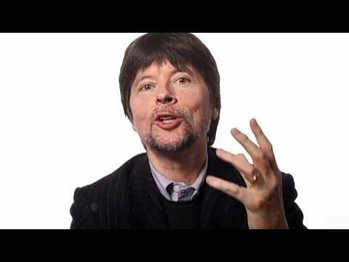
A Newer Perspective

Slide 14
Conclusions Agreed Upon
Science and Technology have progressed beyond man’s ability to manage it
Humans control the physical earth and its patterns
Humans dominate the natural world
Governments are merging into a world system
Man’ intelligence has remained stagnant. We know more, but do we know better?
Man’s moral condition has remained stagnant. Knowledge has not improved our hearts

