Slide 1
Theory of Knowledge
How do you know what you think you know?

Slide 2
Aims
Make connections between a critical approach to the construction of knowledge, the academic disciplines and the wider world
Develop an awareness of how individuals and communities construct knowledge and how this is critically examined
Develop an interest in the diversity and richness of cultural perspectives and an awareness of personal and ideological assumptions
Critically reflect on their own beliefs and assumptions, leading to more thoughtful, responsible and purposeful lives
Understand that knowledge brings responsibility which leads to commitment and action.

Slide 3
Assessments
External Essay
Internal Presentation
Maximum of 1,600 words
On a prescribed title
Individual or Group (limit of 3)
10 minutes per member
You must submit a planning document in order to present

Slide 4
What is this course?
Instead of learning and regurgitating a specific body of knowledge, TOK challenges you to assess HOW you know what you know. It forces you to think critically about the process and ramifications of knowledge.
You will analyze knowledge questions and knowledge claims.
You will distinguish between shared and personal knowledge.
You will focus on the ways of knowing via specific areas of knowledge.
You will apply this process to the real world.

Slide 5
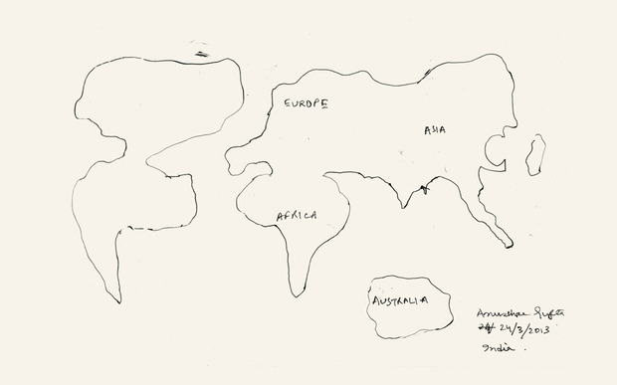
Remember the Map

Slide 6
Knowledge Questions
Throughout our study, we will be posing these types of questions.
These are questions about each facet (area/way) of knowledge:
What counts as evidence for X?
What makes a good explanation for Y?
How do we judge the best model of W?
How can we be sure of F?
What does theory L mean in the real world?
How do we know it is right to do Z?

Slide 7
Ways of Knowing
Language
Sense Perception
Emotion
Reason
Imagination
Faith
Intuition
Memory
You will study four of the eight in-depth.
You will both distinguish among the eight and surmise how they work in conjunction to shape knowledge.

Slide 8
Areas of Knowledge
These are specific branches of knowledge:
Mathematics
The Natural Sciences
The Human Sciences
The Arts
History
Ethics
Religious Knowledge Systems
Indigenous Knowledge Systems
You will study six of the eight.

Slide 9
Topic
Take five minutes.
Describe the smells, sounds, and tastes of Thanksgiving dinner. Be specific and sensory.
Instead of saying, the taste of turkey, say something like, the dry meat that turns to sawdust as I chew
Share your descriptions with the person to your right.

Slide 10
Personal Knowledge
Empiricism: Knowledge through personal experience
Sensory (how do mashed potatoes taste?)
Rationalism: Using reason to approach knowledge
“I think, therefore I am.” Decartes
This is individual and fluid
Personal knowledge is made up of:
skills and procedural knowledge that I have acquired through practice and habituation
what I have come to know through experience in my life beyond academia

Slide 11
Shared Knowledge
This is more systematic and is not dependent on a specific individual.
It is bound and defined by groups.
It is fluid and changes over time.
Creating a Computer
Although we may know how to use a manual to assemble an entire computer with all of its intricate pieces, it is unlikely that one specific person can build a computer from scratch. We use shared knowledge to build it. A person creates the screen, the keyboard, the motherboard, the modem; another assembles the pieces.

Slide 12
Thanksgiving
Go back to the activity where you described Thanksgiving dinner
Try to determine if your knowledge of it is Shared or Individual

Slide 13
A Balance of Shared and Personal Knowledge
Most of your descriptions are based on both shared and personal knowledge.
This is the balance we are going to try to create in TOK:
How do we know what we know both through those areas that are personal: memory, intuition, emotion, imagination and sense perception?
How do we know what we know through those shared areas: language, reason, and faith?

Slide 14
Knowledge Unit
Our first unit will ask you to deconstruct knowledge and its facets so that you can succeed in the remainder of the course.

