Slide 1
THEORY OF KNOWLEDGE Years 1 & 2
KEELER

Slide 2
CODES
Google Classroom
Juniors
jdplavl A-Day
5jyrxua B-Day
Seniors
olruzav A-Day
4mli3kh B-Day
Managebac
https://jacksonib.managebac.com/login
YOU MUST USE MANAGEBAC FOR INTERNAL AND EXTERNAL ASSESSMENTS FOR BOTH TOK AND THE EE (AND LIT)
IF IT IS NOT WORKING, YOU MUST NOTIFY ME ASAP, NOT A FEW DAYS AFTER THE DEADLINE.
TURNITIN
Class: 39133482 (seniors) 39133590 (juniors)
Key: thinking

Slide 3
AT A GLANCE
This course is a core component of the Diploma Program. It is designed to make you a better questioner, knower, and citizen of the world. Unlike many of your other classes, TOK is more fluid in its construction as its directions (and deviations) often depend on individual cohort interests and personalities. It is not, however, a directionless class. We do have certain aims and skills that we develop in the process.
Our Aims include:
to encourage students to reflect on the central question, “How do we know that?”, & to recognize the value of asking that question
to expose students to ambiguity, uncertainty & questions with multiple plausible answers
to equip students to effectively navigate & make sense of the world, & help prepare them to encounter novel and complex situations
to encourage students to be more aware of their own perspectives & to reflect critically on their own beliefs and assumptions
to engage students with multiple perspectives, foster open-mindedness & develop intercultural understanding
to encourage students to make connections between academic disciplines by exploring underlying concepts & by identifying similarities and differences in the methods of inquiry used indifferent areas of knowledge
to prompt students to consider the importance of values, responsibilities & ethical concerns relating to the production, acquisition, application & communication of knowledge

Slide 4
THEMES
Themes: Most of our learning will be housed in one or more of the following themes. These themes allow for us to apply knowledge to the real world
Core Theme: Knowledge and the Knower
Knowledge and Language
Knowledge and Politics
Knowledge and Technology
Knowledge and Religion
Knowledge and Indigenous Societies

Slide 5
AREAS OF KNOWLEDGE
Areas of Knowledge (AOKS): These are also a method of organizing knowledge. Within each AOK, we will investigate the Scope, Perspectives, Methods, Tools, and Ethics so that we understand the breadth and depth of each.
The Arts
History
The Human Sciences
Mathematics
The Natural Sciences

Slide 6
CONCEPTS
The Course is focused on many concepts and their relationship with knowledge, but we will focus on 12 central ones and use them to guide the course curriculum:
Evidence
Certainty
Truth
Interpretation
Power
Justification
Explanation
Objectivity
Perspective
Culture
Values
Responsibility

Slide 7
OUR ASSESSMENTS
We have specific assessment aims as well:
• demonstrate TOK thinking through the critical examination of knowledge questions
• identify and explore links between knowledge questions and the world around us
• identify and explore links between knowledge questions and areas of knowledge
• develop relevant, clear and coherent arguments
• use examples and evidence effectively to support a discussion
• demonstrate awareness and evaluation of different points of view
• consider the implications of arguments and conclusions.
Our IB Assessments
Assessment | Percentage
IA: Exhibition (End of Junior Year) | 33%
EA: TOK Essay (Feb. of Senior Year) | 67%

Slide 8
OUR ASSESSMENTS (CONTINUED)
The Exhibition (Completed Junior Year)
For this component, students are required to create an exhibition that explores how TOK manifests in the world around us. This component is internally assessed by the teacher and externally moderated by the IB at the end of the course. Students base their analysis of three objects on a central TOK theme and given knowledge question.
The Essay (Completed Senior Year)
For this component, students are required to write an essay in response to one of the six prescribed titles that are issued by the IB for each examination session. As an external assessment component, it is marked by IB examiners and graded internally as a summative. Essay titles are not released until the middle of semester one of the senior year.

Slide 9
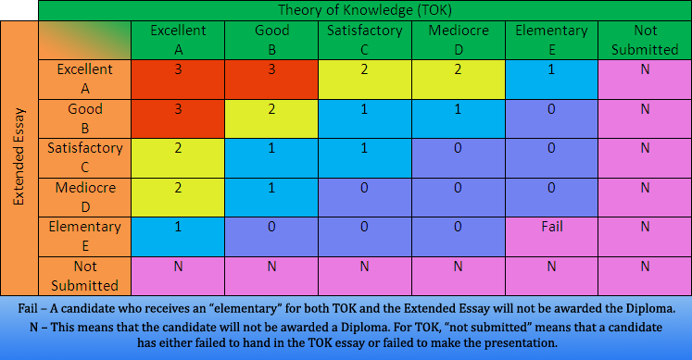
WHY DOES TOK MATTER?
TOK is one of those courses that many students cite as the most impactful in how they think and believe. It should be a course in which you can explore issues and fields of interest.
As a technical explanation, this course, in conjunction, with the EE is required in order for you to earn the IB Diploma.

Slide 10
THE EE
We will have periodic EE days in TOK. TBD
You will receive a grade for your work on these days. They are not free days. If you are not working, you will be given direct assignments to complete instead.
All EE grades go into IB Literature. This is not a part of the TOK gradebook.

Slide 11
SO WHAT IS THE PLAN FOR THE YEAR? Year 1
Our course will be divided by Themes and AOKs
Knowledge and the Knower
Knowledge and Language
Knowledge and Technology
Knowledge and Religion
Classwork:
Most classwork will be discussion and seminar-based. We will also have writing assignments. Your participation is key. I cannot award you for a discussion if you just sat there.
Homework:
Most homework is a continuation of the classwork. It is very important that you meet deadlines.
Projects
You will have projects. TOK and Tell is one project you will complete a few times a year. TOK Journals will also count.
The IA Presentation:
We will begin working toward the presentation after the first unit. The actual presentation date will be in April of the Junior Year in the auditorium. It will be an all-day event.

Slide 12
SO WHAT IS THE PLAN FOR THE YEAR? Year 2
Our course will be divided by AOKs.
We will begin with a conceptual review and move from Maths to the Natural Sciences. The overview is on Managebac.
Classwork:
Most classwork will be discussion and seminar-based. We will also have writing assignments. Your participation is key. I cannot award you for a discussion if you just sat there.
Homework:
Most homework is a continuation of the classwork. It is very important that you meet deadlines.
Projects
You will have TOK Journals and TOK & Tells
The Essay:
We will begin working toward the essay immediately. Because the titles are not released until the middle of senior year, we will not begin actual title work until late semester one or early semester two. This will be a summative.

Slide 13
GRADING BREAKDOWN
The IB Grading Breakdown is as follows:
50% for summative assignments such as major essays, tests, and major projects
30% for formative quizzes and smaller projects
20% for smaller formative assignments such as daily practice/minor homework
You will rarely see a multiple choice test in this class. Almost every major assignment will be an essay or written exam. You will have oral exams as well.
You are expected to use Turnitin.com unless otherwise notified.
I will grant one amnesty day for missing assignments that are not draft assignments. You may make up one formative quiz and two daily formative assignments. It is my expectation that you will meet deadlines in this course so that I can best help you grow. We are humans, so if you have an emergency situation arise, please contact me and I will work with you to extend a deadline.
I automatically grant three days for summative assessments.

Slide 14
ACADEMIC HONESTY
Although more specific policy information is in a Google form, I want to emphasize that academic honesty is paramount to your success. If you are not practicing academic honesty by reading and completing assignments to the best of your ability, you will gain nothing from this course. I cannot help you grow as a writer and reader if you do not practice it.
We follow the APS district guidelines for academic dishonesty.
You must cite your sources at all times. Our standard format is MLA, which was specifically taught to you in the 9th and 10th grade. It is an expectation that you use parenthetical citations and a Works Cited at all times.
This policy also pertains to the use of AI.
If you need help with MLA, please see my website www.msjkeeler.com and I have linked some resources. I am also available for help during tutorial times.
My best advice is to read and try your best. I can help a weak student. I cannot help a duplicitous one.

Slide 15
MY CONTACT INFO
Ms. Keeler
404-409-1114 by text (Please do not text me at midnight)
keelerjacksonhs@gmail.com (This is my preferred email)
jkeeler@apsk12.org (Please do not send assignments here.)
Please feel free to contact me with questions, concerns, or comments at the above. I can usually respond via text in a few minutes. I may respond with a meme.
Official Tutorial Day: Tuesdays 3:45-4:45. I am also available other days if you ask me ahead of time.

